Slide 1
SEF Project “Google Maps”

Slide 2
Table of contents
01
02
03
04
Feasibility Study
Requirements
Function Tables
Diagrams

Slide 3

Part 1
M
T
W
Feasibility Study
T
F

Slide 4
Introduction
M
T
This report will discuss many aspects of the application we chose (Google Maps). We are hoping to provide a clear understanding of the system in a simple way by using the following points:
• Feasibility study & Project proposal
• Project requirements
• Activity diagram
• Project Use Case Modeling
• Sequence diagram
• User Interface Design
W
T
F

Slide 5
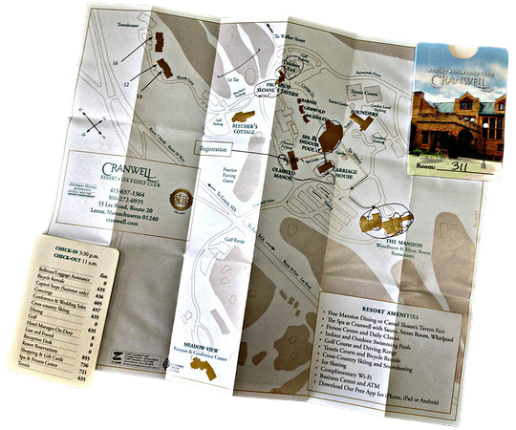
Problems:
M
T
difficulty in sharing locations
ignorance of nearby places
W
Paper maps are hard to update
Paper maps were expensive and hard to find
T
Hard to know the exact directions to the destination
F

Slide 6
Background
M
T
Google Maps
Google Maps is an application provided by Google company, Google
Maps functions simply by allowing users to easily add places they are
familiar with, such as stores, cafes, and other destinations, and easily Figure
out the shortest path to their destination.
W
T
F

Slide 7
Proposed solution
M
T
1
2
3
4
5
W
T
Google Maps can provide solutions for finding nearby places of
interest by suggesting locations and giving them directions until arriving at
their destination in addition to allowing users to share their location in real time.
F

Slide 8
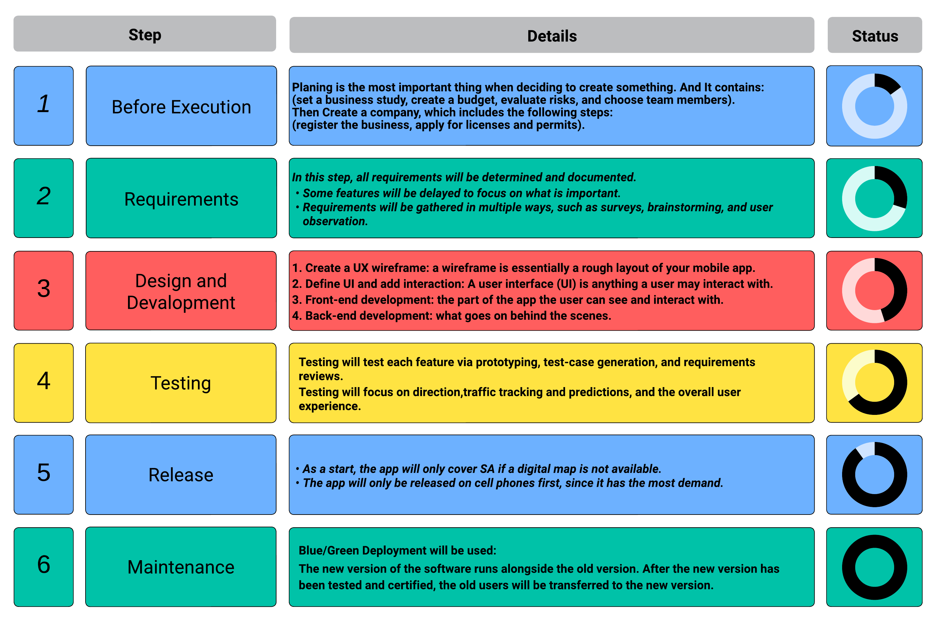
Work plan
M
T
W
T
F

Slide 9

Part 2
M
T
W
Requirements
T
F

Slide 10
Non-Functional Requirements
No. | NFR | Goal – Specifying metric
1 | High Availability | This system is impervious to failure. We do not want our consumers to become lost in an inaccessible location.
2 | Good Accuracy | The predicted journey duration (ETA) is not expected to shift much from the actual travel time.
3 | Responds promptly | Within 5 seconds, the response needs to be available.
4 | Fast refresh time | Map data provided by Google is updated every second (Update/sec) .
5 | Auto localization | Google Maps should automatically take you to a country domain and shows place names in a country’s local languages .
ETA | THE ESTIMATED TIME OF ARRIVAL.

Slide 11
Functional Requirements
M
The program should give users some details about the travel.
The program should display the ETA while travelling between two points.
The program should display the distance between two points.
The program should allow users to add information to the places.
The program should allow registered users to add business.
The program should allow registered users to add reviews on business.
The program will allow users to login with their accounts if they already have an existing account.
The program should allow registered users to add comments and questions about locations.
The program must allow businesses owners to add and modify their business.
The program must allow businesses owners to suggest changes on their business.
The program will allow users to register to get more features.
The program will allow users to register and create new accounts.
T
W
T
F

Slide 12

Part 3
M
T
W
Function Tables
T
F

Slide 13
Google Maps: Add business
Actors | Registered user, Google Maps administrator.
Description | A registered user can apply to add his business by pinning the location. After that, he must enter the required information; the last step is to prove business ownership. Then the administrator will review the request and approve it.
Data | Business owners are struggling with the visibility and accessibility of their businesses.
Stimulus | Business owners struggling with the visibility and accessibility of their business.
Response | Approval will make the business appear on Google Maps.
Comments | If possible, the request will be sent to the administrator in the same region. More information could be required, depending on the type of business.

Slide 14
Google Maps: Add suggestion
Actors | Registered user, Google Maps administrator, and business owner.
Description | Suggestions can be taken from registered users to edit place details like place name, category, phone number, etc., or if the business does not exist. The request will be sent to the business owner to fix the issue If no response comes, the request will be handled by the business owner.
Data | Issue details (place, type of issue) and a description of the solution.
Stimulus | A place that has incorrect or out-of-date information.
Response | Fix incorrect place information.
Comments | Corrections must be made within three days.

Slide 15

Part 4
M
T
W
Diagrams
T
F

Slide 16
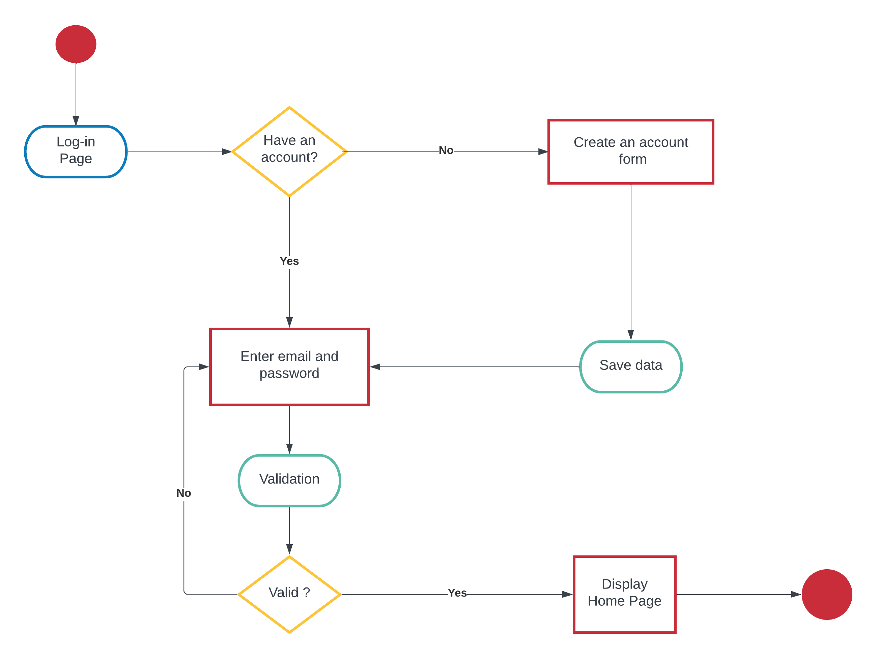
Activity Diagram
M
T
W
T
F

Slide 17
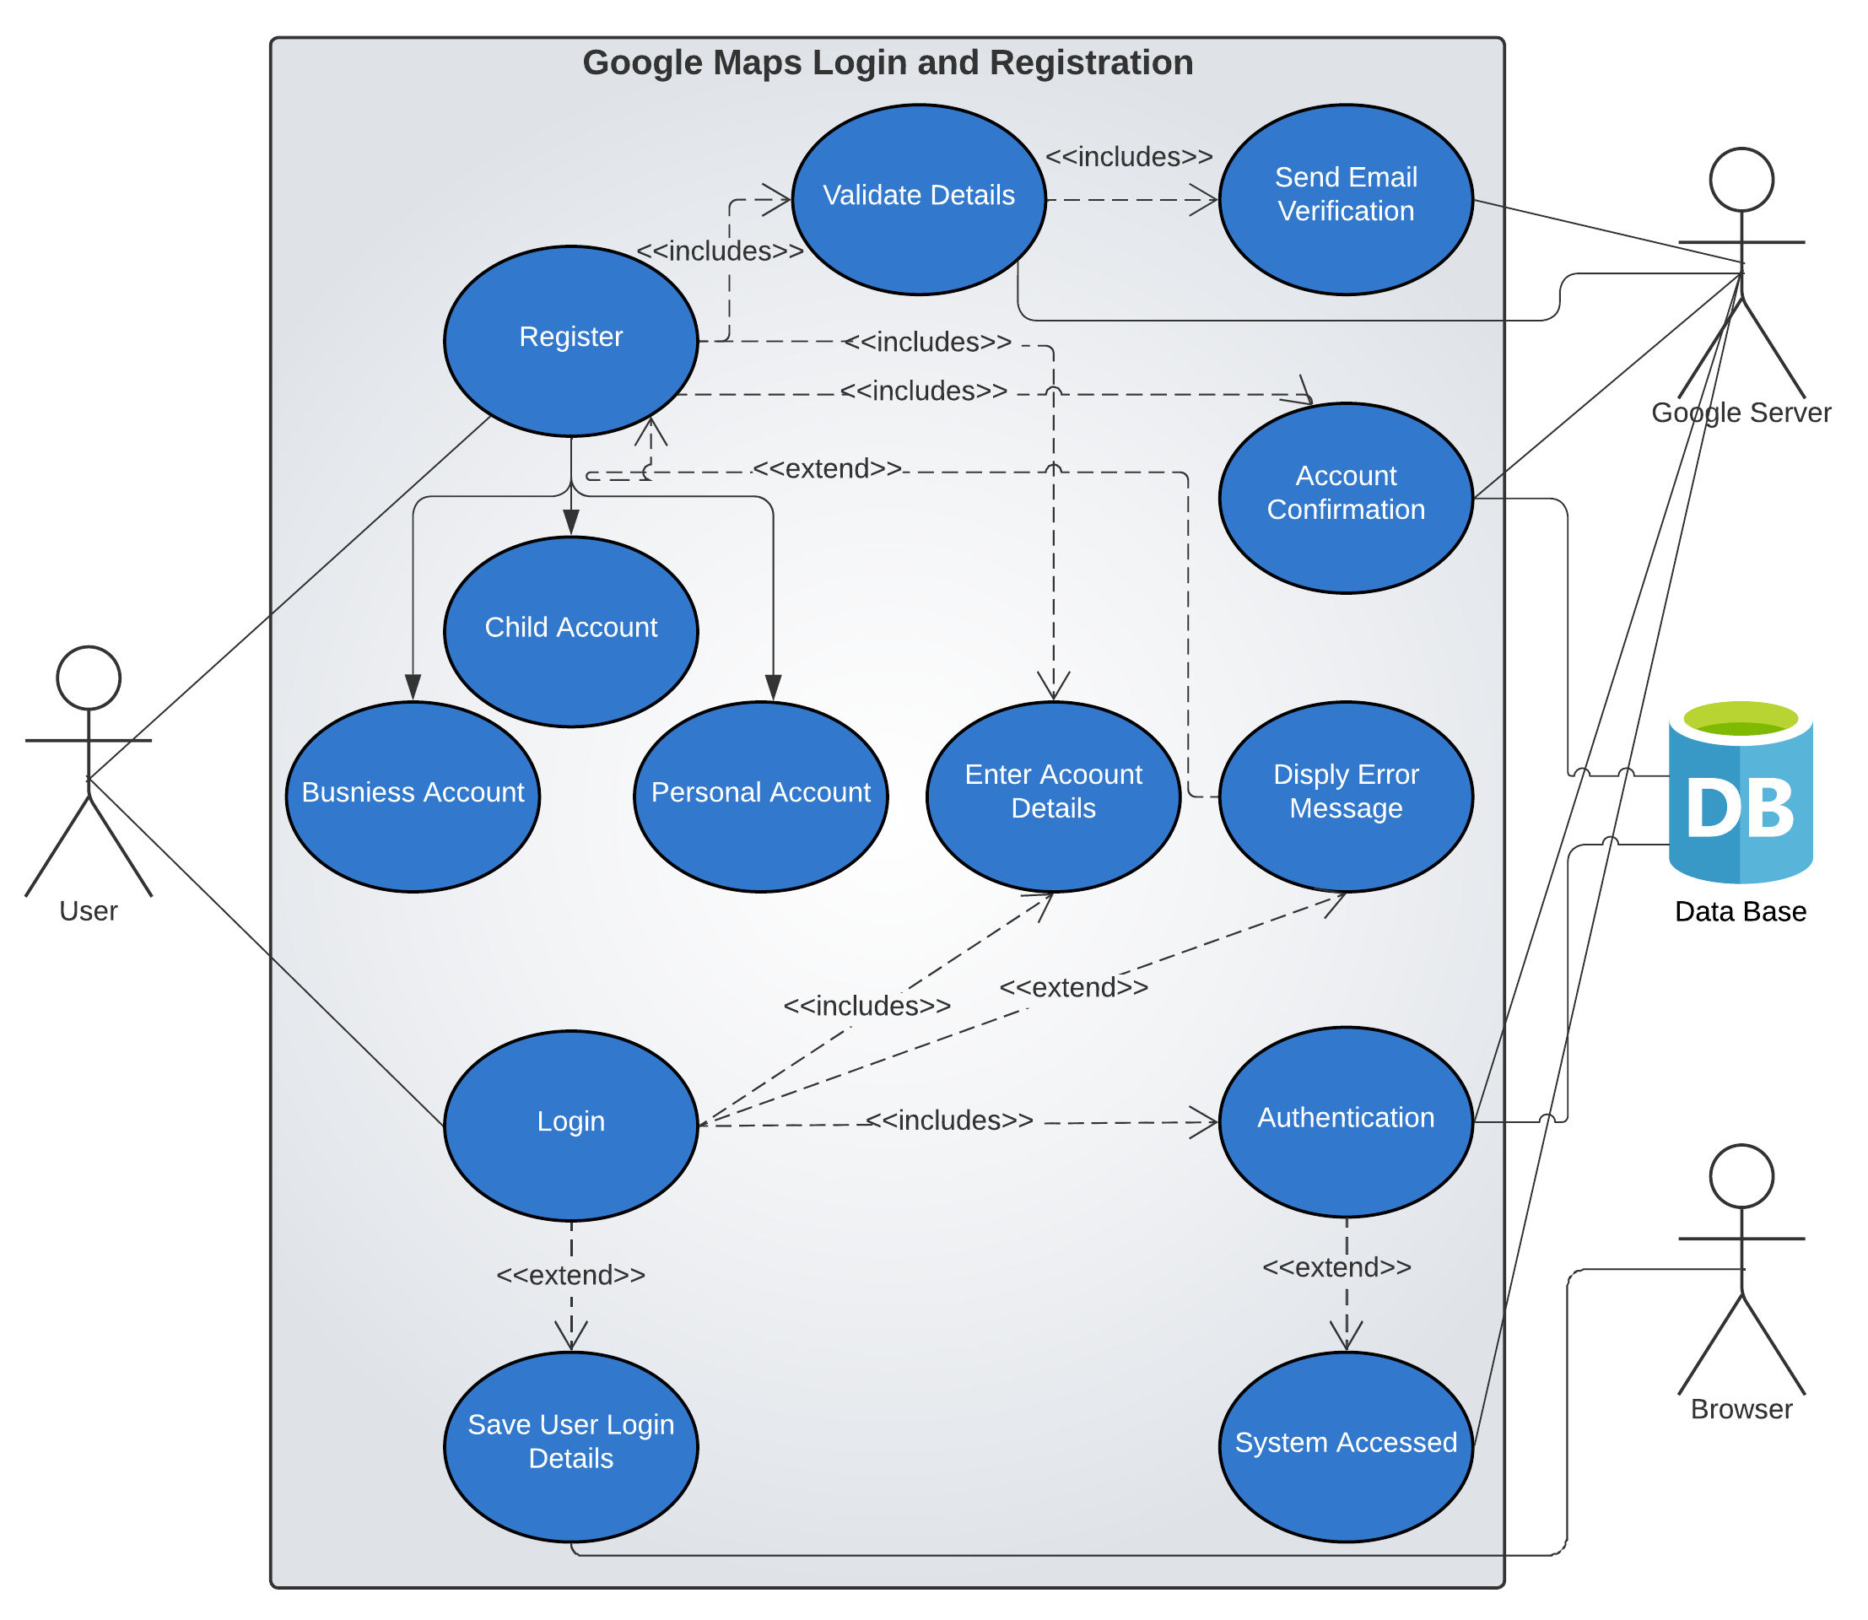
Use Case(login and registration)
M
T
W
T
F

Slide 18
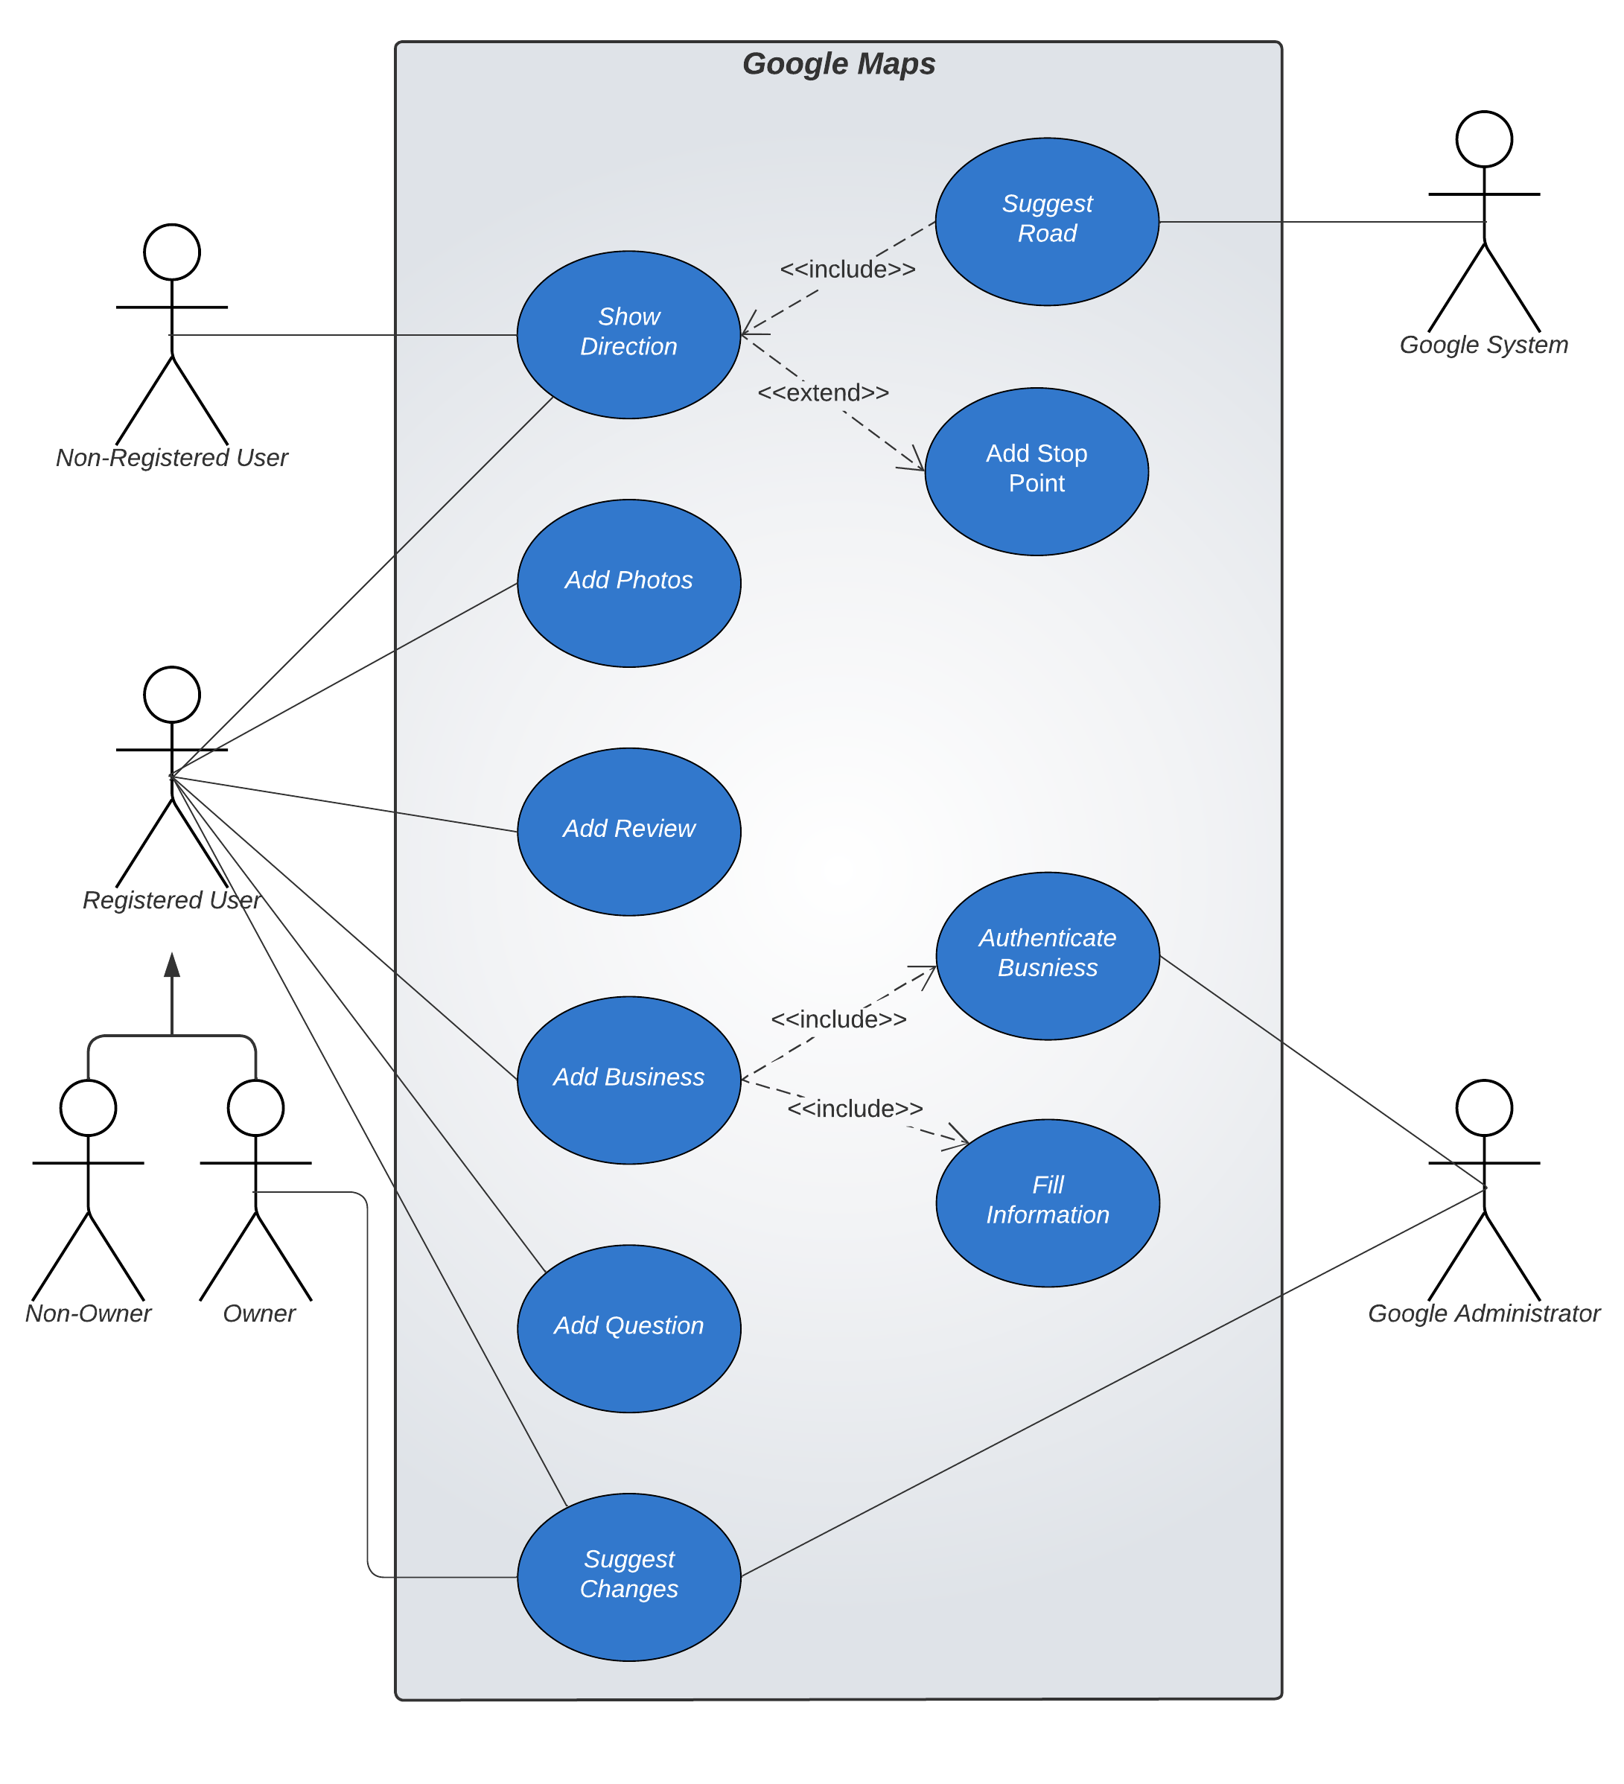
Use Case(login and directions)
M
T
W
T
F

Slide 19
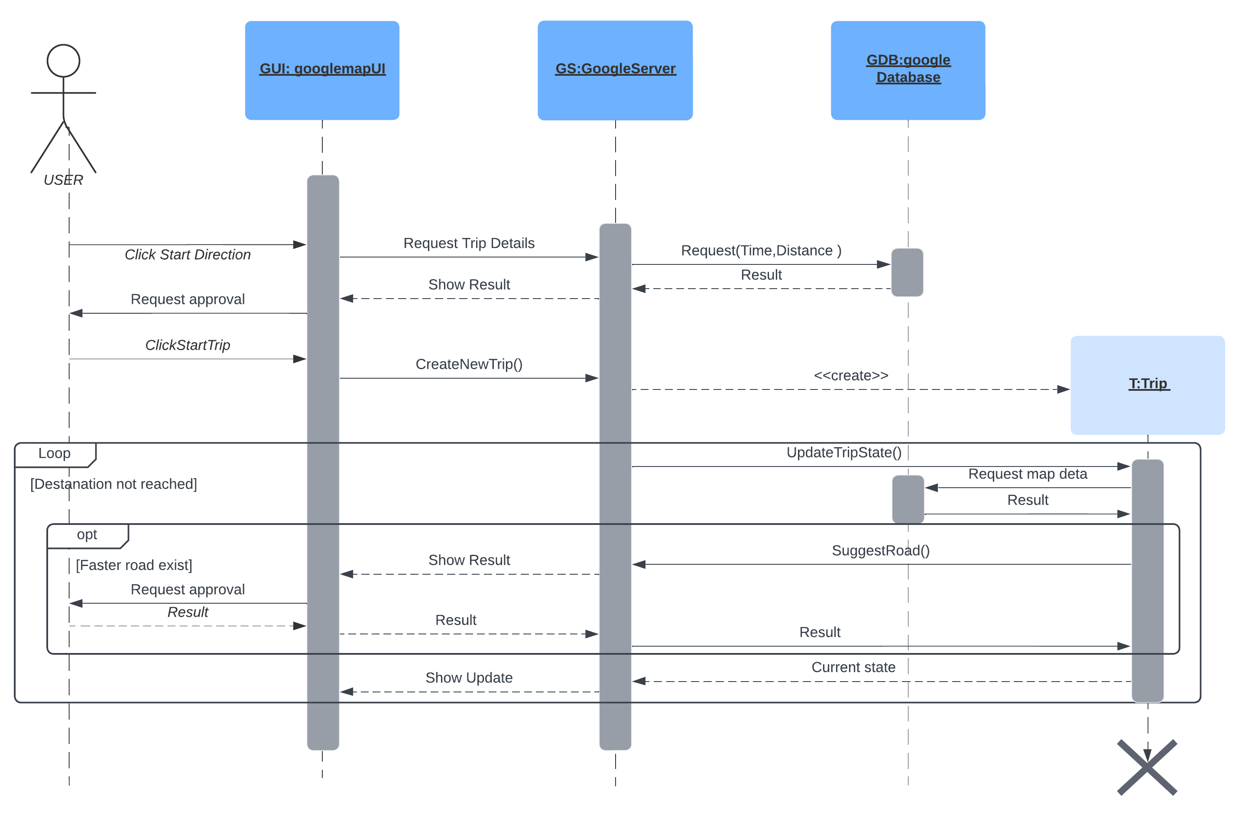
Sequence Diagram
M
T
W
T
F

Slide 20
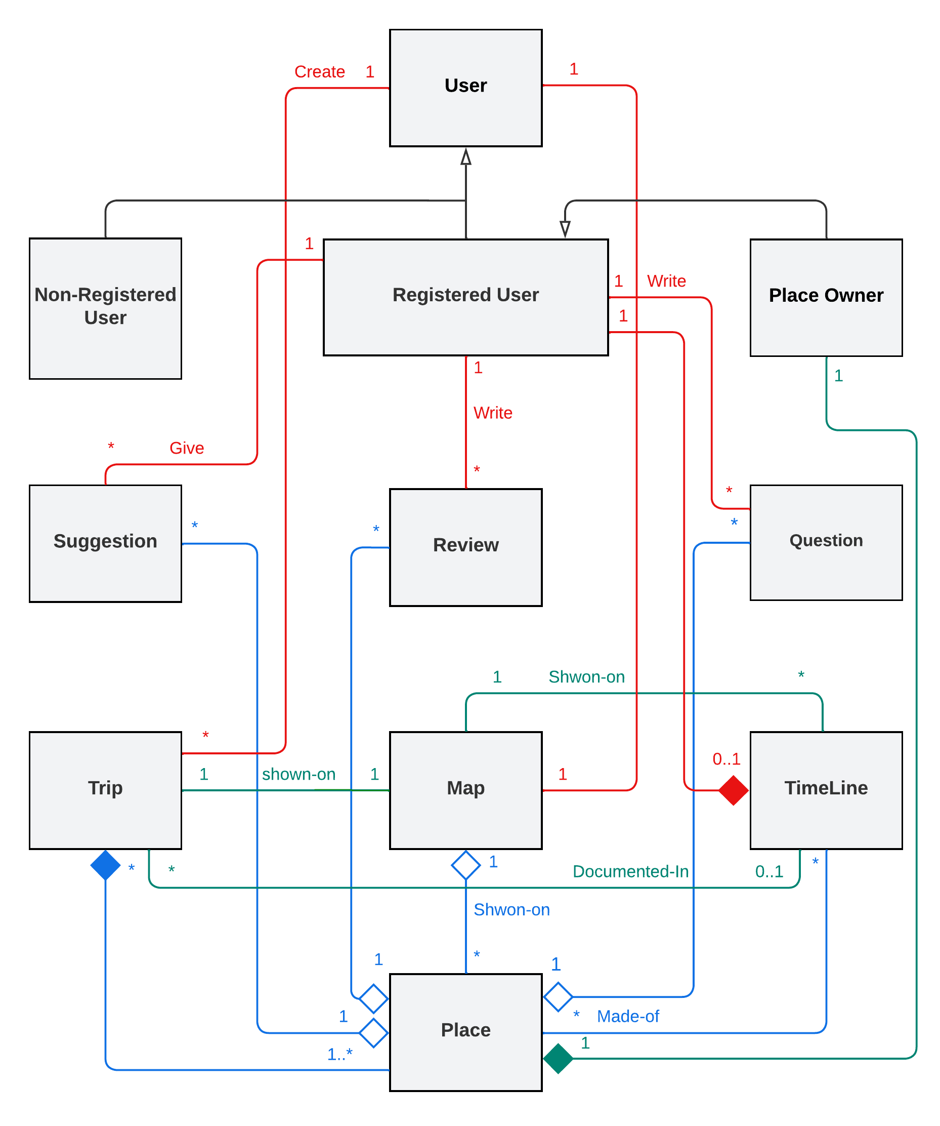
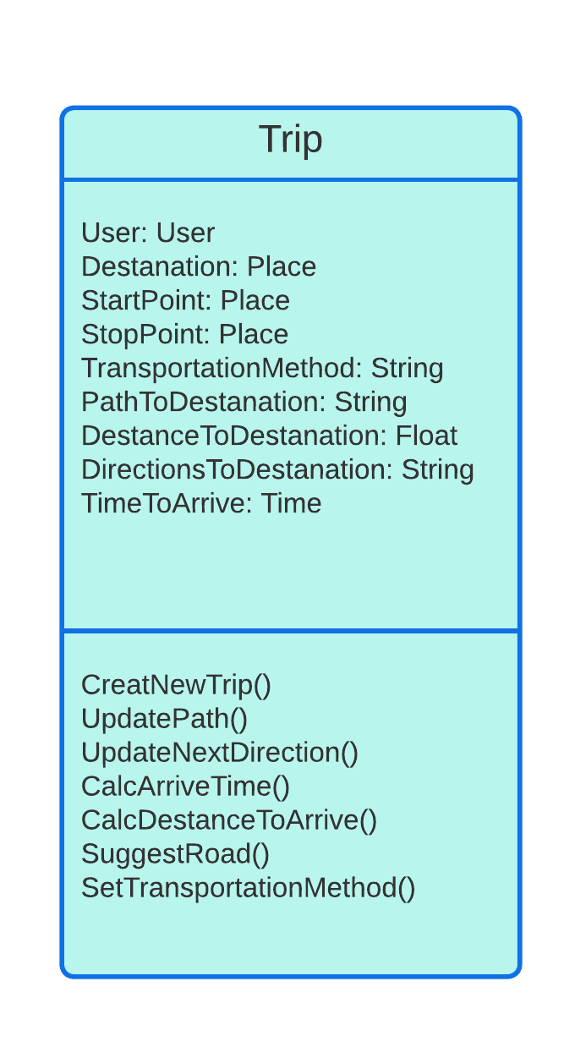
Class Diagram
M
T
W
T
F

Slide 21
Thanks
Do you have any questions?

